Slide 2
Automated Feedback System For Non-Functional streetlight
Submitted to:
Department of Computer Science and Engineering

Slide 3
Supervised by: Prof.Ambrish Srivastav
Team Members
1. Mayank Solanki (0827CS201134)
2. Kanishk Chouhan (0827CS201112)
3. Khushboo Sen (0827CS201114)
4. Mahak Soni (0827CS201127)

Slide 4
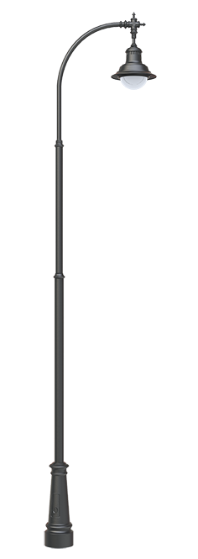
Project Presentation Outline
Abstract
Introduction
Problem Statement
Survey of Existing Systems
Project Objectives
Requirement Analysis
Solution Proposed
Implementation
Methodology
How to use
Conclusions and Limitations

Slide 5
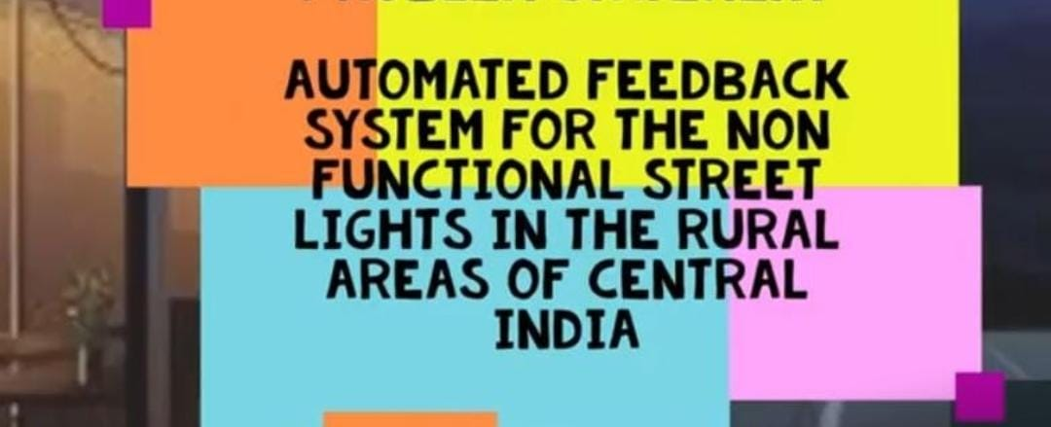
Abstract
Street light plays a very important role when it comes to road safety and security.
However, in many cases, these lights remain inactive due to the latest information about the exact location and the unavailability of adequate service support.
The software-based automated response system may allow service engineers to know the exact location of traffic lights that are not working in their area of responsibility.

Slide 6
Introduction
As good street lighting conditions are required to improve the safety and security of people, especially at the night in rural areas because the road conditions are not always good at all places which can cause severe accidents and many more problems.
It is not like the authorities don’t want to resolve the issue but they don’t have the proper information/exact location So an Automated feedback system is required to solve this issue in which the people can report the non-functional streetlight.

Slide 7
The Problem Statement
Good Street lighting systems in rural areas improve road safety, and personal security and raise the standard of living.
Street lighting also improves safety for drivers, riders, and pedestrians on rural roads, where the road conditions are sometimes not of the desired standards.
However, many times these lights remain non-functional due to late information about the exact location and unavailability of sufficient service support.
An automated feedback system based on software may allow the service engineers to know the exact location of non-functional streetlights in their areas of responsibility.

Slide 8
Survey of Existing Systems
Manual system: In the manual system one has to report about the nonfunctional street light by going to the government offices where one has to apply to the issue which will be given to a government official and then all the applications keep on getting piled up and no one takes the responsibility to resolve the issue even after so many attempts.
Advantages
Provides a sense of face-to-face communication which people believe is more effective.
We get to explain the problem in detail.

Slide 9


Survey of Existing Systems
Disadvantages
It takes a long period to resolve the issue.
Issue may not get resolved definitely.
Meaningless usage of the resources.
Documentation has to be done.
Gaps identified
One has to stand in queues in the government office to register complaint about the non-functional streetlight.

Slide 10
Objectives
The main aim of this project is to develop a software system that allows the user to report non-functional street lights.
It’s to ensure safety by the means of software that will directly report to the concerned authority about the issue.
Thus road accidents will be reduced and safety will be improved very efficiently.
A central database will record all the information about the requests and resolved issues.

Slide 11
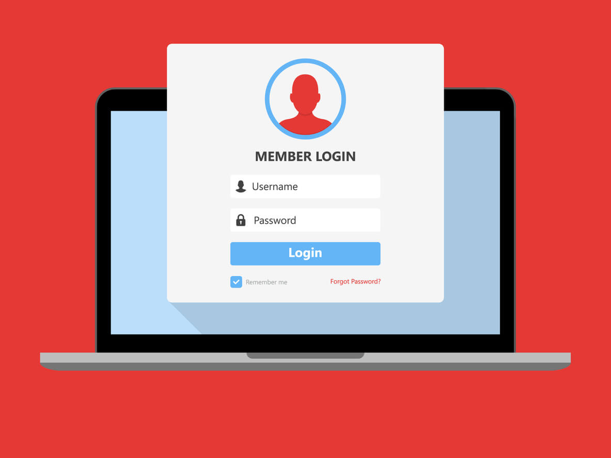
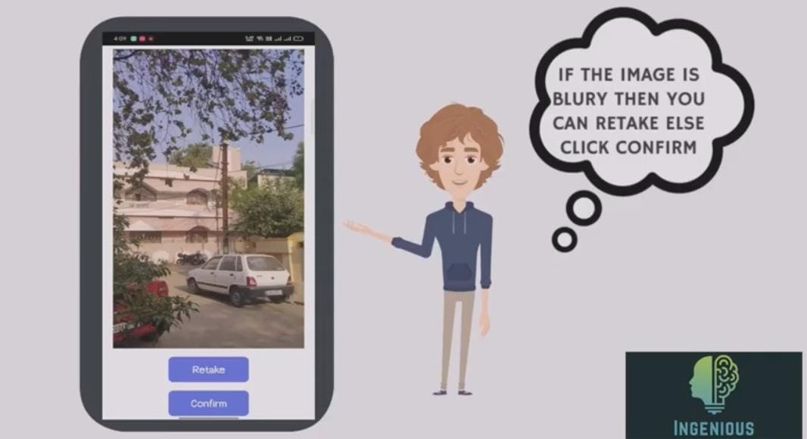
Requirement Analysis
Functional requirements
Authentication of the user whenever he/she logs in to the system.
A Verification email is sent to the user whenever he/she registers for the first time on the software system.
User can upload a picture of the non-functional streetlight.
User can describe the issue in the description box.

Slide 12
Requirement Analysis
Non-Functional requirements
The processing of each request should be done within a seconds.
The software can adapt to changes in the environment.
This software will be scalable and reliable.
It is a portable software that can be used at any time, any place.
It has flexibility and can be used by any age group.
It provides security and maintainability.

Slide 13
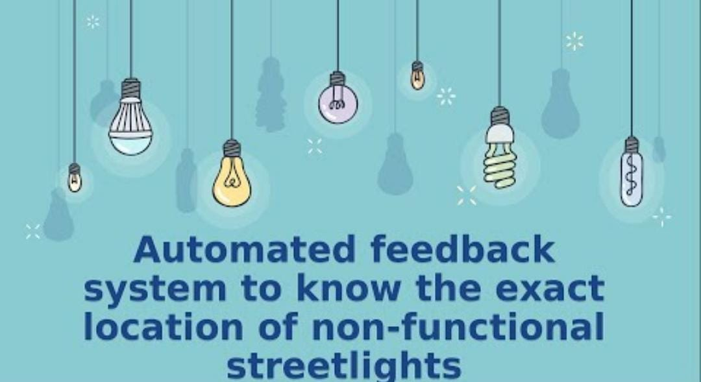
Solution Proposed
This project is to develop a software system that allows the user to self-report the inoperative streetlights.
This system is primarily based on the request generated by the user to solve an issue.
For automatic feedback, the user needs to register on the platform using our app and then file a complaint about the non-functional street light.

Slide 14
Solution Proposed
In software engineering, a software development methodology is a splitting of software development work into distinct phases (or stages) containing activities with the intent of better planning and management.
It is often considered a subset of the system development life cycle. In software development methods, there are different methods used for software development. We have selected to develop this software using agile methodology.

Slide 15


Solution Proposed

Slide 16
Implimentation
Technique Used
SQLite
This SQLite tutorial teaches you everything you need to know to start using SQLite effectively. In this tutorial, you will learn SQLite step by step through extensive hands-on practices.This SQLite tutorial is designed for developers who want to use SQLite as the back-end database or to use SQLite to manage structured data in applications including desktop, web, and mobile apps. SQLite is an open-source, zero-configuration, self-contained, stand-alone, transaction relational database engine designed to be embedded into an application.

Slide 17
Implementation
Android studio
Android Studio is the official Integrated Development Environment (IDE) for Android app development, based on IntelliJ IDEA . On top of IntelliJ's powerful code editor and developer tools, Android Studio offers even more features that enhance your productivity when building Android apps, such as:
A flexible Gradle-based build system
A fast and feature-rich emulator
A unified environment where you can develop for all Android devices

Slide 18
Implimentation
Apply Changes to push code and resource changes to your running app without restarting your app
Code templates and GitHub integration to help you build common app features and import sample code
Extensive testing tools and frameworks
Lint tools to catch performance, usability, version compatibility, and other problems
C++ and NDK support
Built-in support for Google Cloud Platform, making it easy to integrate Google Cloud Messaging and App Engine

Slide 19
METHODOLOGY
This project is to develop a software system that allows the user/person to self-report the inoperative street lamps and helps to solve the problem as soon as possible.
This project is to develop a software system that allows the user/person to self-report the inoperative street lamps and helps to solve the problem as soon as possible.
While registering the complaint, the user is asked for the image of the dysfunctional street lamp and after the image is approved, he/she has to fill in the location details. After the image is verified by the technician, it will be stored in the complaint database.

Slide 20
METHODOLOGY
This stored complaint will then be made visible to the relevant authorities or technicians and to the user who has filled out this complaint. After visiting the application, review all the complaints lists and select the complaint that was given to it.
With the help of the coordinates, the technician will reach the exact location of the dysfunctional street light. After successful resolution of the complaint, the user will be notified that the complaint has been successfully resolved. This is how we automate the feedback process. And the exact location of the complaint solved the problem.

Slide 21
METHODOLOGY
The application was developed using android studio version 2021.2.1 and JAVA language along with concepts of object oriented programming for the back-end and XML for the front-end development . The minimum SDK required to run this application is API 21: Android 5.0 (Lollipop) and hence this application will run on approximately 98.8% devices. The project was divided into multiple modules to ease the process of application development.

Slide 22
How to use ?
The user can file a complaint using the app in only five simple ways:
Step 1- Login
The first step towards filing a complaint through this app is to login into the app using the login credentials which will redirect the user to the main home page of the application.
Step 2- Upload photo
Whenever the user is filing a complaint on the application he or she has to upload the photo of the non functional streetlight on the application itself.
Step 3- Select location
After uploading the photo the user has to select the location of the non functional streetlight.

Slide 23
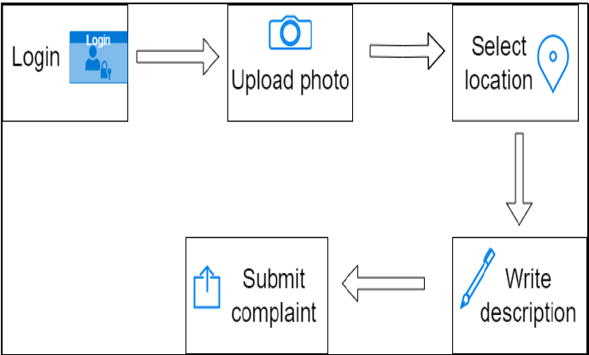
How to use ?
Step 4- Write description
Then after performing the above two steps the user has an option to write a description about the issue it can also be left blank.
Step 5- Submit complaint
And the final step is to click the submit button button to file the complaint.

Slide 24
Limitation
One of the main limitations of these projects is that the application will not be able to work without a proper internet connection because the database has to be updated frequently for the proper functioning of the system.
Non functional streetlight is not automatically recognized by this application

Slide 25
Conclusion
The proposed Automated feedback system is a reliable platform for both the common people and the government officials as it provides proper data in an organized manner which ensures the smooth functioning of the department responsible.
It is an application that helps minimize human error and data redundancy issues.
It is a fast and efficient method of communication between the common people and government bodies. The proper working of the street lights will avoid accidents and thus increasing the likelihood of saving lives.

Slide 26
Acknowledgment
We would like to extend our heartfelt gratitude to our computer science and engineering department for giving us with this great opportunity to work on this project.
We would also like to express our sincere gratitude to Prof. Ambrish Srivastav for his valuable guidance and kind supervision throughout the course of this project.

Slide 27
Q&A

Slide 28
THANKS

